Slide 1


Anti-Depression Chatbot
Impacting and Improving lives through AI

Slide 2

Mission: Revolutionising mental health space with technology through innovation

Slide 3

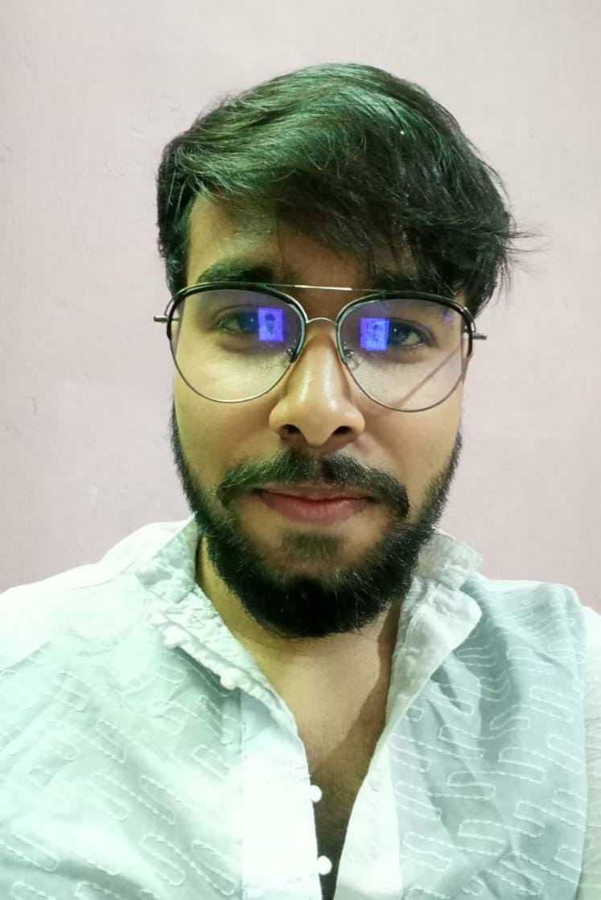
The team
Being college undergrads with lots of expectations and responsibilities, we experienced depression and mental health issues such as anxiety and stress on a first hand basis which really drove us towards innovating a solution for the problem
Debargha Saha (CEO)
Manojit Roy (CTO)
College Senior - Final Year Engineering (B.Tech in ECE)
College Senior - Final Year Engineering (B.Tech in ECE)
A problem solver and technology geek who loves to leverage technology to solve problems and issues and build products
A budding engineer, problem solver, passionate about ML, and AI, having a strong interest in projects that require both conceptual and analytical thinking, and always eager to learn more.

Slide 4
The Problem
Mental Health and Depression are a rising cause of concern in the young generations of the Indian population today in the age group of 18-25, which leads to poor quality of life in the youngsters making them go through an extremely tough and uncomfortable phase of life, some leading to severe implications as well. 1 in 7 children is facing mental health issues every day in India. Many of the youngsters face mental disorders like depression, anxiety, ADHD, Schizophrenia, and a lot more. Unfortunately, less than 1% of them get medical help, as topics like mental illness aren’t talked openly about.
Depression rates by each year (2016 - 2020)
60%
42%
30%
21%
2017 | 2018 | 2019 | 2020

Slide 5

The solution
We plan to solve this problem through a conversational AI Chatbot. The chatbot we have planned can converse with the user in a well disposed manner and comprehend the sentiments and feelings of the user exactly. The chatbot utilizes AI calculations to do as such and afterward closes to the state of the client. If the client is recognized with any sort of dysfunctional behavior or misery then the chatbot attempts to give them the home solutions for adapt up to their psychological and enthusiastic state. On account of significant issues, for example, suicidal thoughts then the message and notice is additionally send to guardian of the client.

Slide 6
Milestones
Show where you are in the process and what’s left to tackle
October 2021
June 2021
August 2021
Started building the actual product and built the ML model to leverage with the the product
Ideation phase - Started off with the idea
Jan | Feb | Mar | Apr | May | Jun | Jul | Aug | Sept | Oct | Nov | Dec
Prototype phase - Prototyping the solution and conducting market analysis and research

Slide 7
How it helps to solve the problem?
Our chatbot fights against the 3 primary reasons for mental disorder(as recorded) as Unhealthy competition (in every field), Social media, and anxiety(usually introduced in our life through a smartphone), Lockdown(recent reason).
Our chatbot has been deployed in these social media(FB messenger, Slack), which is used frequently nowadays. Our bot is a conversational bot which is specialized in dealing with psychologically unhealthy situations. The healthy interactive, and friendly conversations with the chatbot(Name: Noob), technically, focuses on helping the user to share their feelings, letting them know about various ways for being in a mentally good and healthy mood through various videos, blogs, jokes, and a lot more. Eventually which helps to deal with loneliness. In fact, this chatbot provides medical support after determining clinically urgent depressive disorder.

Slide 8
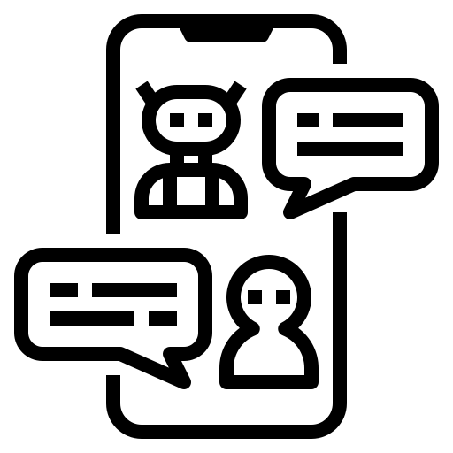




How it works
Step 1
Step 2
Step 3
Step 4
The user responds to the chatbot and gradually the conversation gets carries on
Through deep user conversations and simple questionnaires the mental status of the user is tracked down
Our chat assistant gets initiated manually by the user through a tap or click on the deployed platform
The chatbot initiates the conversation with a welcoming message, or any time
with a simple “Hi”!

Slide 9
Impact Metrics used to analyze the Effect of the Solution of the Problem
User Feedback and Reviews - The feedback and reviews of our ChatBot will serve as a key metric for determining the success or failure of the Effect of our solution and possible improvements and ways of future extension of our solution to the market and more users.
User Engagement - Capability of our chatbot to initiate conversation with the users and interacting with them to share information. Ability to classify the target audience, delivering meaningful messages, taking direct orders from users, and navigating to layouts and more are some of the key user engaging attributes which would result in ensuring a good retention rate of users.
Comprehension Capabilities - The capabilities of our chatbot to ensure a good texting and error free experience for the user. Ability to detect spelling mistakes and errors in a sentence input by the user is the best example of comprehension capabilities. Our chatbot should be able to understand intent based text such as differentiating between a request and order. One more criteria is to have the “balanced text use” which means our chatbot will use a combination of both short descriptions and engaging content like rich media to hold the user’s attention.
Speed - Our chatbot should be able to help the users instantly, which directly relates to the response speed of the chatbot. We have integrated our chatbot with knowledge-based database and programmed to fetch information and respond quickly. Hence, measuring the response rate of our chatbot plays an important role when it comes to speed. Hence a key metric is the capability of delivering responses immediately for effective interactions.
Functionality - Ability of our chatbot to greet users, guide them with the onboarding steps, how to use the chatbot to their best and how to access all the services of the chatbot. These should be the well-designed functionalities which need to be kept in mind for retaining a great conversational flow.

Slide 10
Frameworks/Tools/Platforms(integrated)/Technologies stacks to be used
Natural Language Processing(NLP)
IBM Watson Assistant
IBM Cloud
Facebook Messenger
Slack

Slide 11
Assumption, Constraints and Solution Decision Points
NLP - It’s highly important modern technique to analyse sentiment from textual data obtained from the user.
IBM Watson Assistant - It’s highly efficient, and beneficial to build a chatbot.
Constraints:
Lack of dataset(Intent Examples, Entities, etc.).
Subscription limitation in Lite version.
Very limited domain knowledge(Help from experts would be beneficial).
Lack of experience of using IBM Watson Assistant(Mentor guidance would be beneficial).

Slide 12
Extent of Scalability/Usability
The chatbot itself can be later on scaled to any working website or android application in itself, or can be integrated in social media(Facebook Messenger, Slack Workspace) through channel integration.
Later on we can add medical support facilities (such as Doctor Appointment, Video Calling facilities) to our chatbot.

Slide 13
Solution Implementation Feasibility and Effectiveness
We plan to deploy our solution using IBM Cloud services(IBM Watson Assistant) primarily extending our Anti-depression chatbot services to Slack and Facebook Messenger as an AI assistant which the users can access just like normal chats.
Effectiveness of this Chatbot will be very high as our Chatbot will be live on the most commonly and widely used Social Networking Platforms where more than 3 billion active users are found monthly, it targets on the 3 primary reasons against mental disorder, easy to interactive, friendly, with guaranteed data security theme.

Slide 14

Methodology
Concepts, Principles, elements and components

Slide 15
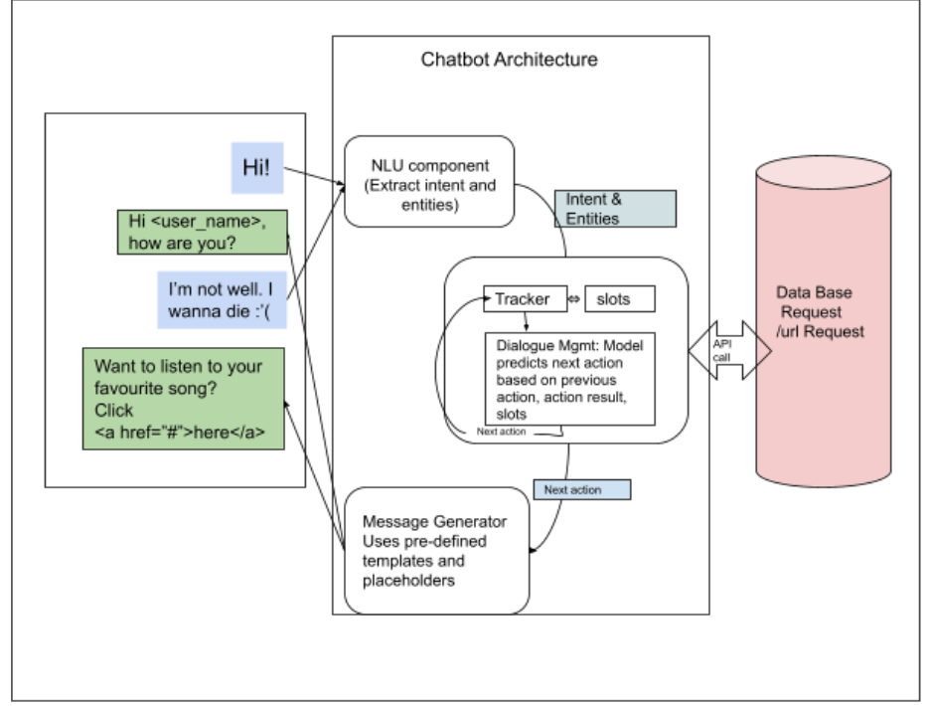
Architecture Diagram

Slide 16
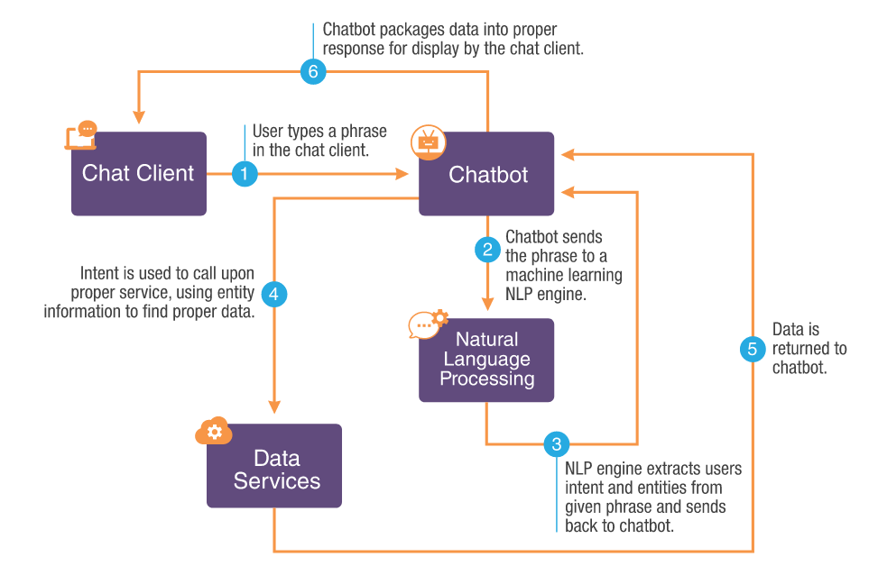
General Flowchart for Chatbot

Slide 17
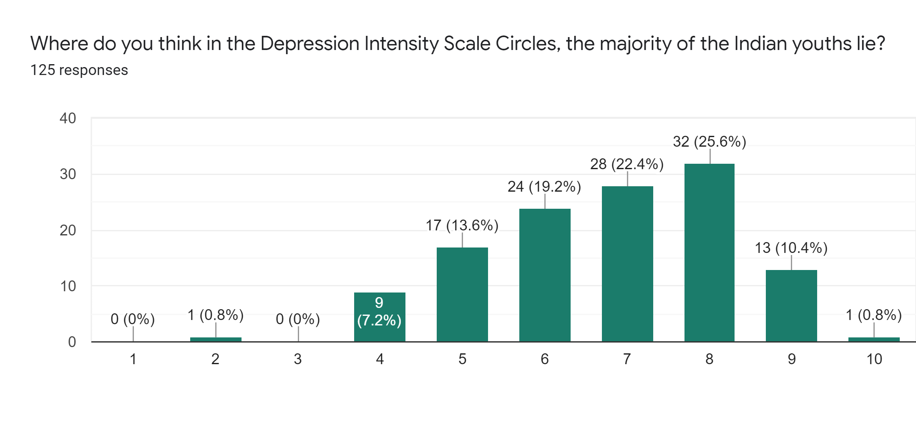
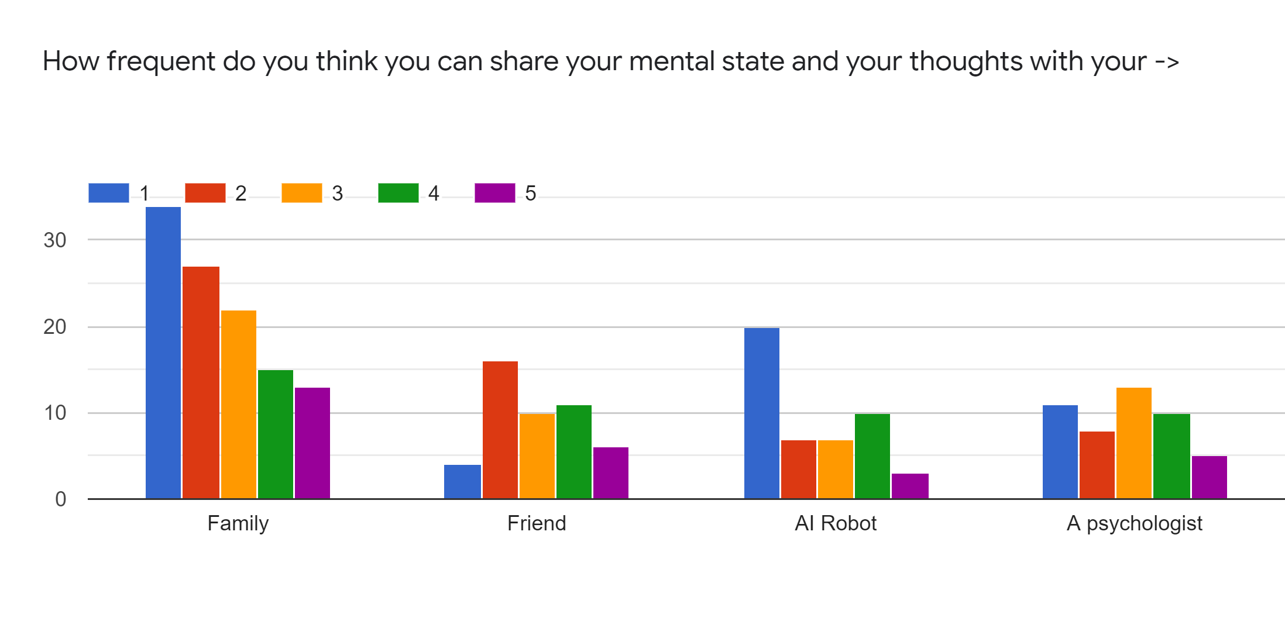
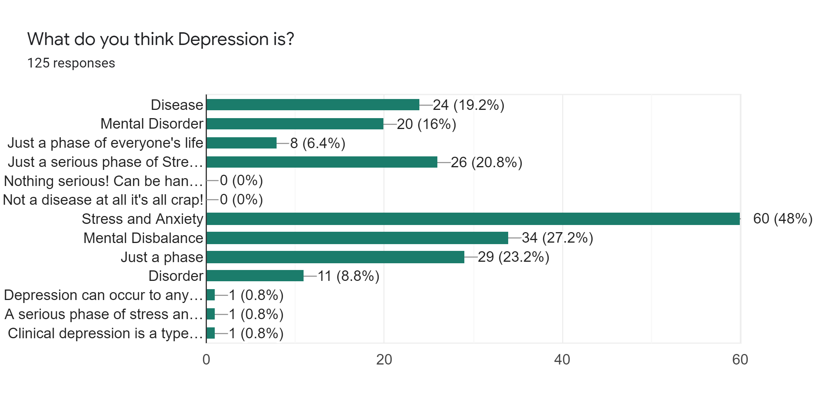
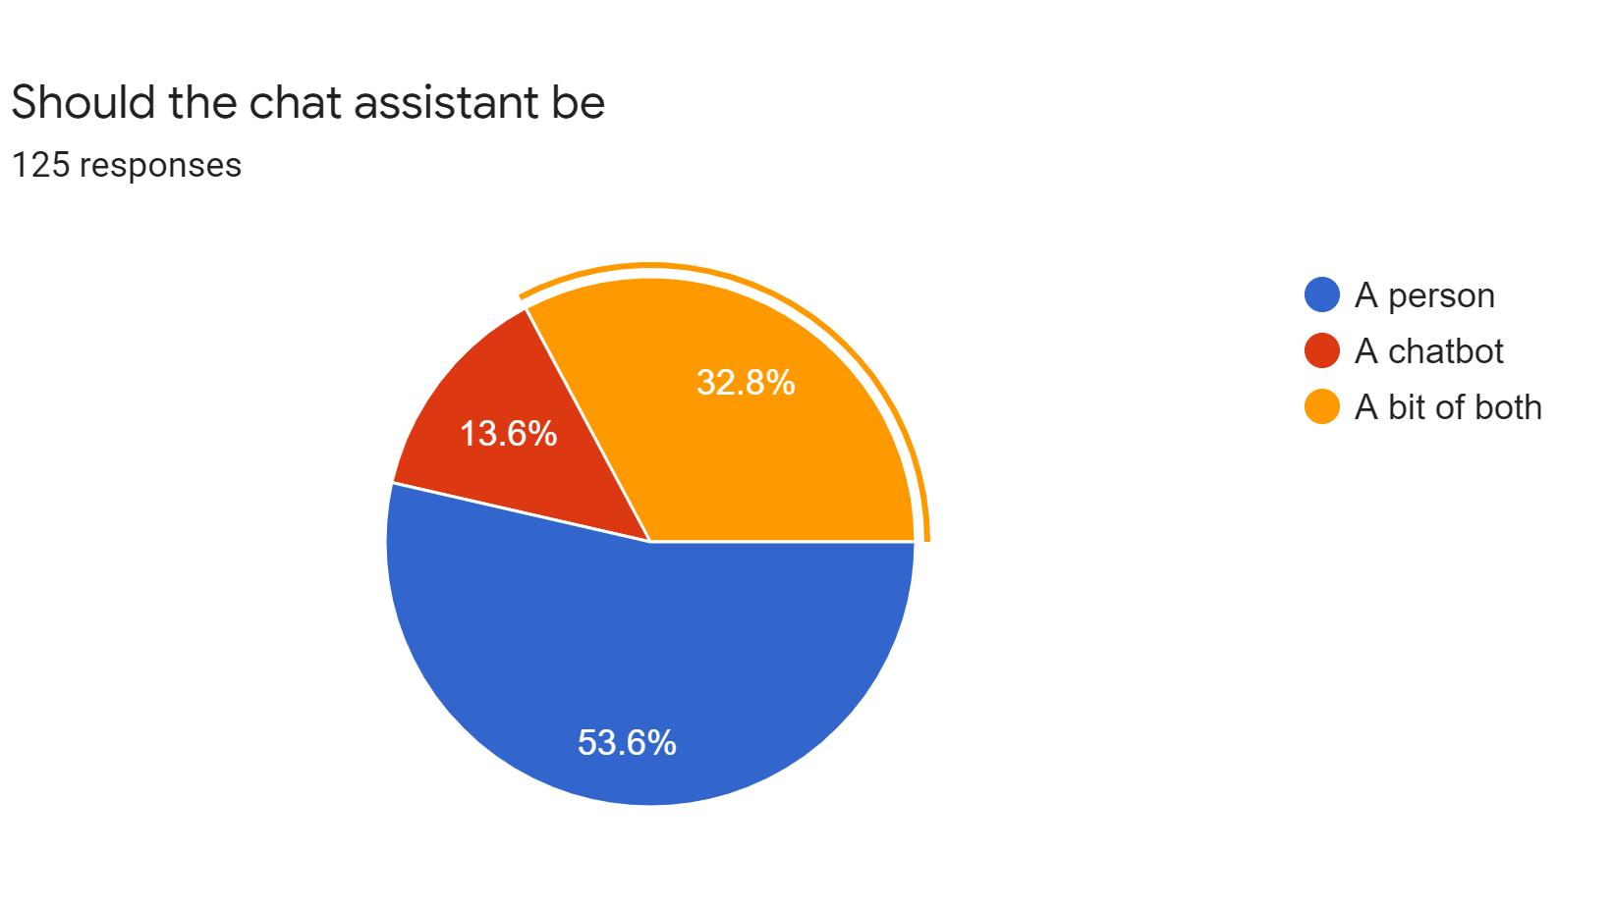
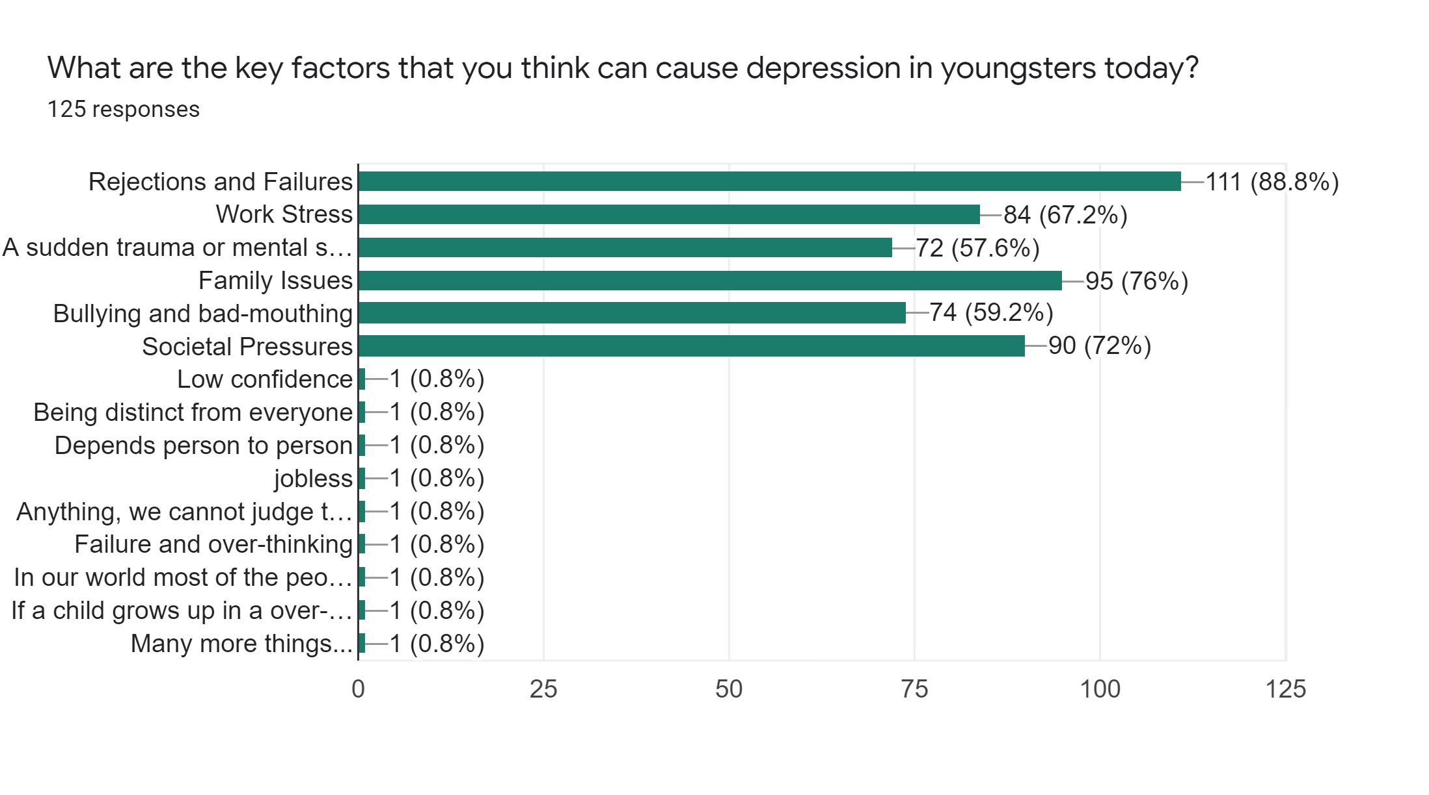
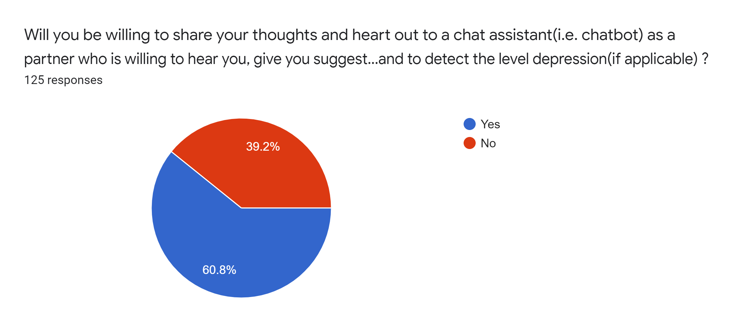
Graphical Representation
To understand our users and audiences better, we conducted a user-survey with curated set of questions related to Mental health, depression, chatbot usage, their daily activities, habits and behaviours to understand our audience better and take a peek into their thought processes and their expectations from the product we are building. The following graphs shows the responses of few of the questions from the survey form with the help of creative graphical representation.

Slide 18
Analysis and Visualization
The three important research we conducted before progressing with the idea were -
Consumer Research & Need
Product Research & Strategy
Market Research
We identified the pain-points, gaps, needs of our targeted audience and customers of our product
Product specifications, demonstrations, beta version feedbacks and researching about similar products which has already proved themselves in the market. Defining product use cases and features exclusively
Identified our potential competitors, market size and potential market cap. Identified existing market trends, common themes, characteristics and similarities among similar products and their respective customer base
Analysis and Summary
From all the above studies conducted, we analyzed the profitability, scalability, feasibility, sustainability and growth of this idea keeping in mind the future challenges to this Product Startup. We discovered the Strengths, Weaknesses, Opportunities and Threats (S.W.O.T analysis) of our idea to better prepare and position ourselves from the start. We scanned all our interaction touchpoints at each level for our product to reach our customers with a goal to create excellent user experience at each touchpoint for our product. We set the right value proposition strategy based on the user-surveys and the research studies we conducted to provide our customers with the right values on 4 metrics - Performance , Financial, Emotional and Relational value.

Slide 19
Revenue model
Product (Chatbot)
Essential and Primary Services (Chatbot advices, suggestions, normal conversation, playing videos and fun activities)
All Services provided by the product (Chat Counseling, advices, guidance, health suggestions etc.)
Advanced features and personalized services (Counselling, support and healthcare suggestions, personal chat assistant through google account services)
Users can also go for direct subscription based on several subscription plans to access all the services of the product
Users can initially opt for services which are free and can continue to use the chatbot for absolutely free
The revenue model that we plan to use for our product or idea is a mixture of two models -
Freemium Model and Subscription Revenue Model
(Basic Account - Free)
Subscription Plan (yearly or monthly) - Paid
Upgradation
Premium Account - Paid (Different Plans)

Slide 20
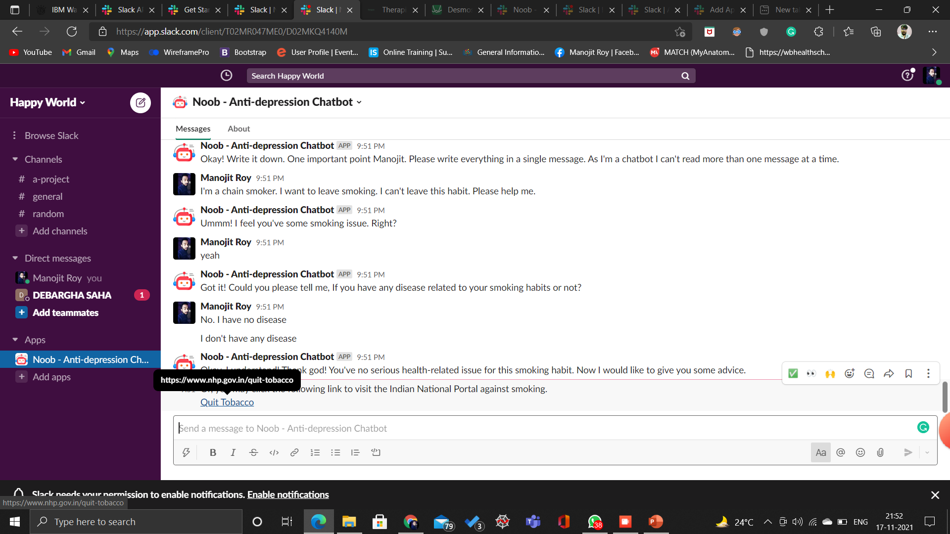
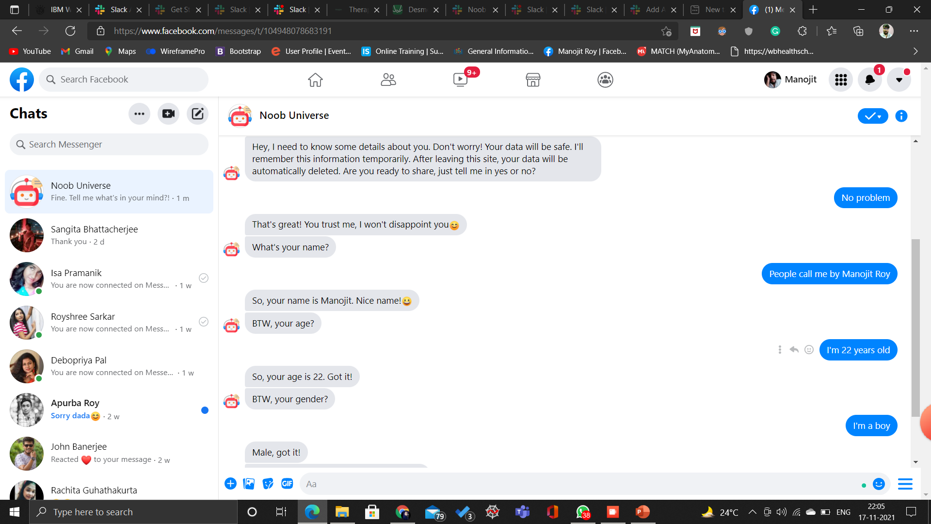
Screenshots of the working chatbot(Chatbot)
Deployed on Messenger 👇🏼
Deployed on Slack 👆🏼

Slide 21
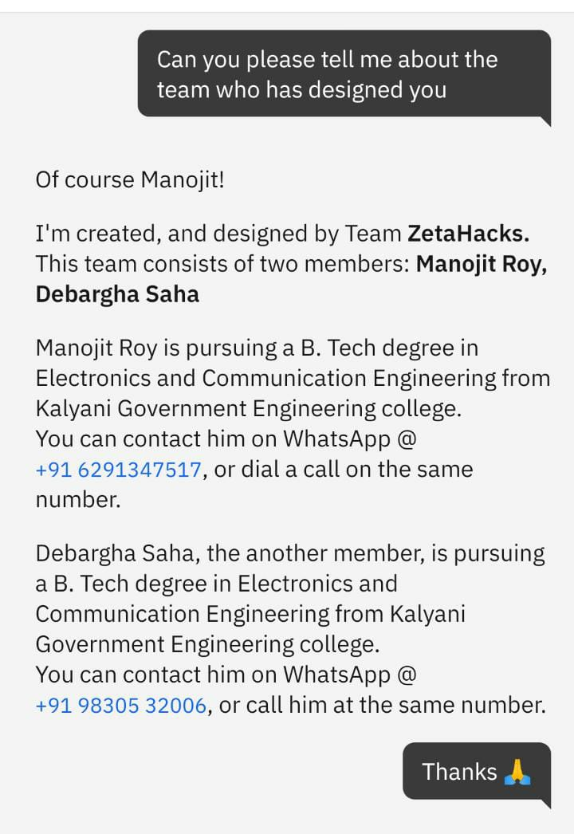
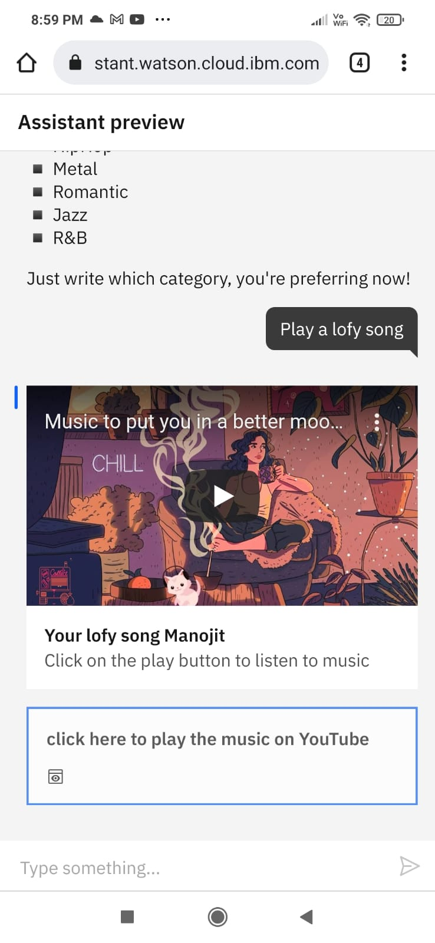
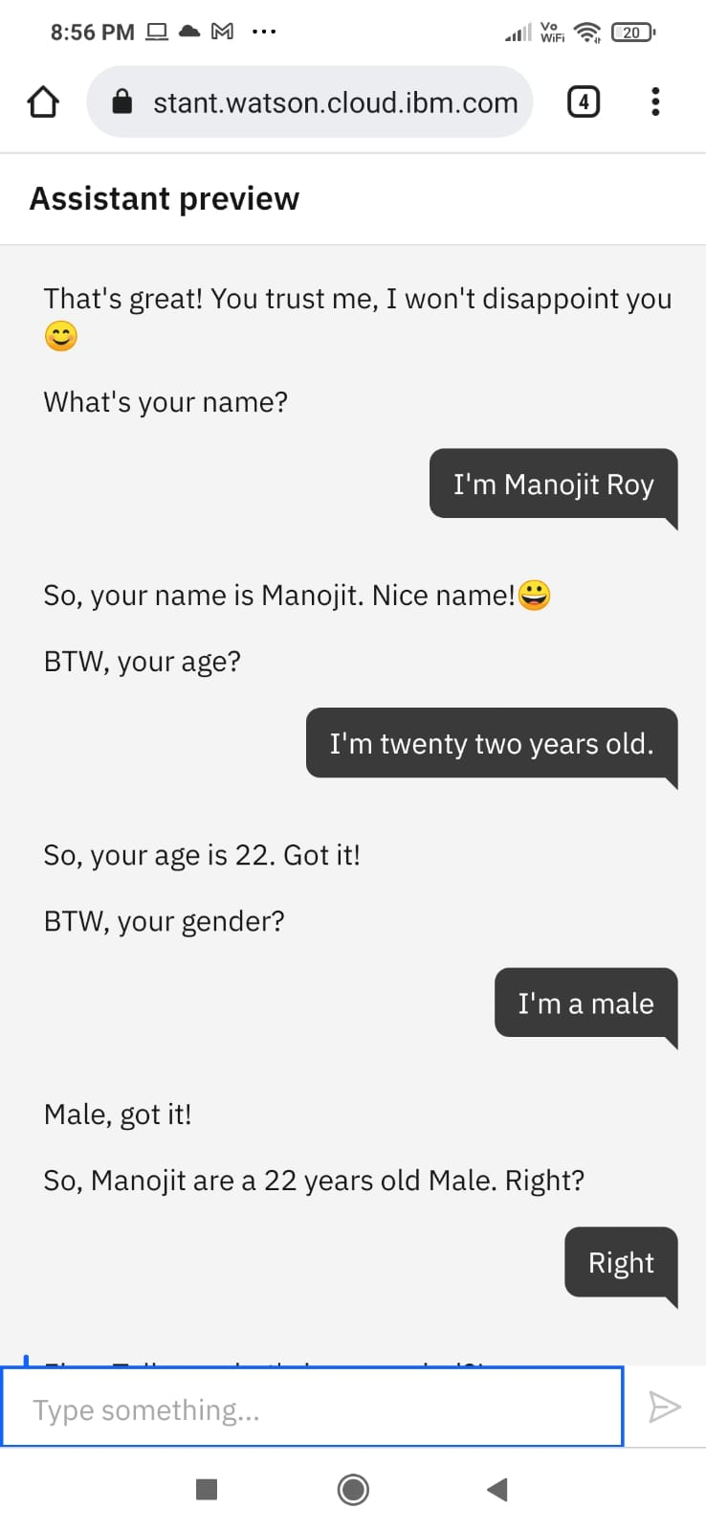
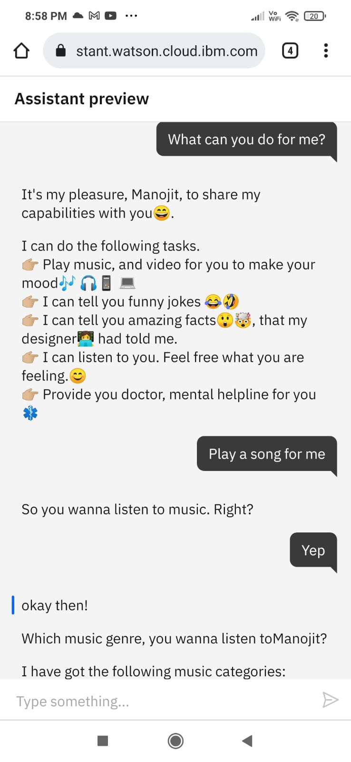
Screen Shots(Assistant Preview)

Slide 22
Demo Link and Video Link for our Chatbot
IBM Assistant Preview (Chatbot) - https://bit.ly/noob-anti-depression-chatbot
Chatbot deployed on Slack - https://bit.ly/anti-depression-slackbot
GitHub Repo Link - https://github.com/Stark-developer01/IBM_Hackathon
YouTube Video Link - https://youtu.be/aqsg0jHIwBo

Slide 23
Appendix
For user queries, feedback and suggestions we have created a google form where our users can share their feedback as well -
User Response Survey post Chatbot Use - https://forms.gle/L9DacwyjrPdgxyZL9

